Slide 1


-- Gurdeep Juneja
-- Dec 10th, 2024

Slide 2
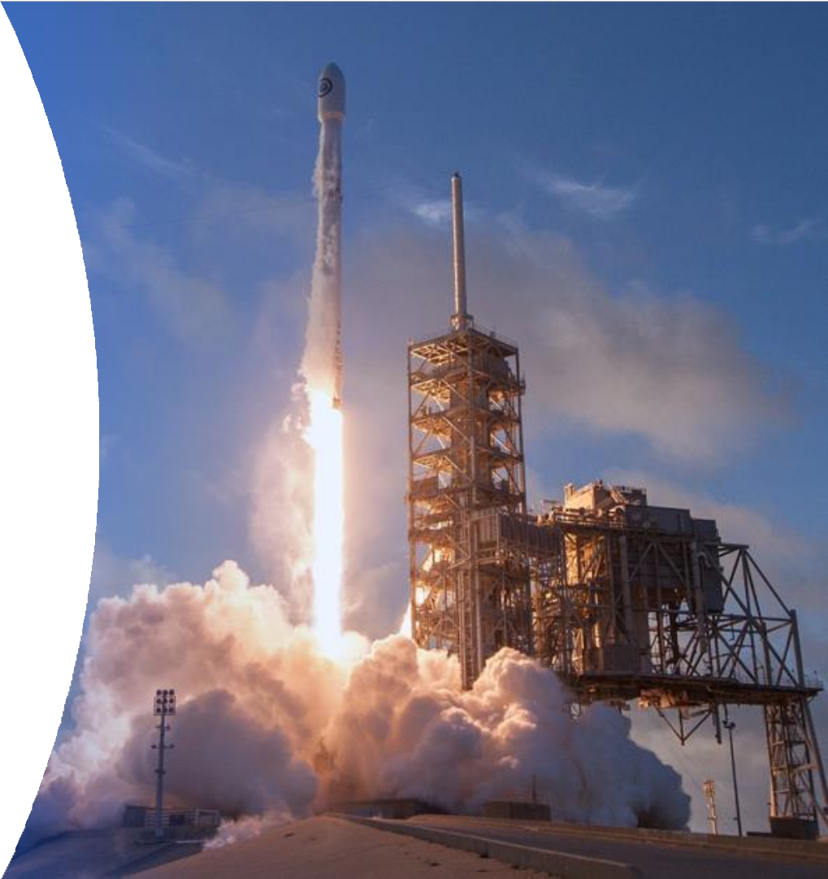
Outline
Executive Summary
Introduction
Methodology
Results
Conclusion
Appendix
2

Slide 3
Executive Summary
Today, SpaceX is considered on of the best companies over the world in terms of space rockets launches, due to the rocket science advancements that achieved in making space missions more affordable and practical, generally space rockets companies offer a rocket launch with a cost of 165 million dollars, whereas SpaceX offers by the same service for only 62 million dollars which considered a huge savings led organizations such NASA to sign contracts with SpaceX.
In this report, I am taking the role of a data scientist working for a new rocket company, called SpaceY that would like to compete with SpaceX founded by Billionaire industrialist Allon Musk. my job is to use data science instead of rocket science to discover the possibility of competing with SpaceX. I am doing this by gathering information about SpaceX, performing data analytics, modeling ML algorithms and creating dashboards for my team.

Slide 4
Introduction
Since 1957, the countries around the world are competing to expand beyond Earth, whether through satellites launches or space exploration, these missions require huge amounts of money where a launch of one space rocket costs in average 165 million dollars, a company like Space X changes the equation by reducing this amount of money massively to only 60 million dollars due to its unique and advanced technologies in returning the first stage of rocket structure.
As mentioned above one of the key factor of SpaceX’s success in the space race is the first stage of rockets return through a safe landing, from this point we will discover together what are the main attributes or variables that control these successful landings, through asking questions about the nature of the launch process , the payload mass of rocket, launch location, rocket orbit, and more by analyzing and visualizing these information through the data science methodology provided by IBM.

Slide 5

5

Slide 6





Methodology
Data collection Methodology:
The data was collected using SpaceX rest API in addition of using data web scraping on Wikipedia webpages.
Perform data wrangling:
The data was preprocessed using Panadas and NumPy, some of main technique are used: OneHot encoding, unnecessary columns removal, data normalization and standardization.
Perform exploratory data analysis (EDA)
Using libraries such as seaborn and matplotlib for visualization and SQL for data quires.
Perform interactive visual analytics
Using the following libraries Folium and Plotly Dash
Perform predictive analysis using classification models
Starting with splitting the data into train and test sets
Identifying the best algorithm and parameters through hyperparameters tuning using Grid Search
6
Adopting the best algorithm and parameters for the purpose of model deployment.

Slide 7

Data Collection
We have collected the data from two main sources:
SpaceX API: Open Source REST API for launch, rocket, core, capsule, starlink, launchpad, and landing pad data.
Wikipedia: is a free online encyclopedia, created and edited by volunteers around the world and hosted by the Wikimedia Foundation
The Process of data collection:
SpaceX API
JSON Format
Pandas Data Frame
Jupyter Notebook
on IBM Watson
Wikipedia Web Scrapping
TXT Format

Slide 8
Data Collection – SpaceX API
We started the data collection from SpcaeX API by importing the required libraries such as pandas, NumPy and Request, then we established a URL GET request, this request is raised as JSON file to be finally converted to a data frame through choosing the required information like the geospatial info, rocket type, orbit, flight number and more.
Jupyter Notebook on IBM Watson
SpaceX API
GET Request
JSON Response
Data Collection Process from SpaceX API
GitHub URL of the completed SpaceX API
calls notebook -- GitHub link --
Data Frame

Slide 9
Data Collection - Scraping
As we have done before we start by
Jupyter Notebook on IBM Watson
Wikipedia webpage
importing the required Python libraries
GET Request
beautiful soup and request to perform our task, and this time, we have used a webpage on Wikipedia called “Space X Falcon 9 First Stage Landing Prediction” as a data source, then we initialized an HTTP Get Request and the response was as a text format, then we used the beautiful soup library to extract the tables and columns effectively from the text
TEXT Response
response to be converted later to a pandas' data frame.
GitHub URL of the completed web scrapping
task notebook -- GitHub link --
Data Collection via Wikipedia webpage scrapping
Beautiful Soup
Data Frame

Slide 10

Data Wrangling
In this stage we started by importing pandas and NumPy,
GitHub URL
of the completed Data
loading our collected data in the previous stage to
wrangling notebook -- GitHub link --
perform our exploratory data analysis which aimed to clean the data and choose the valid features for training a machine learning model.
Data Wrangling stages
2- Identifying and calculating the percentage of the missing values in each attribute
3- Identifying which columns are numerical and categorical:
1- Loading the collected dataset.
4- Calculating the number of launches on each site
5- Calculating the number and occurrence of each orbit
6- Creating a landing outcome label from Outcome column
7- determining the success rate of returning the first stage of the rocket

Slide 11
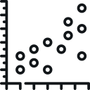


EDA with Data Visualization
EDA with Data Visualization Stages
In this stage we completed our EDA process through finding the correlation between the features and the target using different visualization tools via seaborn and matplotlib furthermore we have performed feature engineering by converting categorical features into dummy values.
Visualize the relationship between Flight Number and Launch Site
Visualize the relationship between success rate of each orbit type
Visualize the relationship between Payload and Launch Site
Visualize the relationship between Flight Number and Orbit type
GitHub URL of the completed EDA with data visualization notebook, -- GitHub link --
Visualize the relationship between Payload and Orbit type
Visualize the launch success yearly trend

Slide 12

EDA with SQL
SQL Quires
Display the names of the unique launch sites in the space mission.
Display 5 records where launch sites begin with the string 'CCA’.
Display the total payload mass carried by boosters launched by NASA (CRS).
List the date when the first successful landing outcome in ground pad was achieved.
List the names of the boosters which have success in drone ship and have payload mass greater than 4000 but less than 6000.
List the total number of successful and failure mission outcomes.
List the names of the booster versions which have carried the maximum payload mass. Use a subquery.
List the failed landing outcomes in drone ship, their booster versions, and launch site names for the in year 2015.
Rank the count of landing outcomes (such as Failure (drone ship) or Success (ground pad)) between the date 2010-06- 04 and 2017-03-20, in descending order.
In this stage we used SQL quires as shown on the right to complete our EDA on our collected dataset
GitHub URL of the completed EDA with SQL notebook, -- GitHub link --
12

Slide 13

Build an Interactive Map with Folium
Building an Interactive Map with Folium
We started our interactive map by drawing 4 circles on 4 different sites belongs to Falcon 9 rockets lunches have the following information:
In this stage we used folium library to represent our work as geospatial data by drawing markers circles and lines on an interactive map.
Launch Site | Lat | Long
CCAFS LC-40 | 28.562302 | -80.577356
CCAFS SLC-40 | 28.563197 | -80.576820
KSC LC-39A | 28.573255 | -80.646895
VAFB SLC-4E | 34.632834 | -120.610746
GitHub URL of the completed interactive map with Folium map notebook, -- GitHub link --
We put markers to on the same sites to represent the successful/failed
first stage of rockets return using marker objects :
Finally, we calculated the distances between the launch site (CCAFS LC- 40) to its proximities 1-the closest city, 2-coastline, and 3-highway. Then we drew polylines to represent these distances using PolyLine object.

Slide 14

Build a Dashboard with Plotly Dash
Building an Interactive Dashboard with Plotly Dash
We added a dropdown list to enable Launch Site selection including the following options:
All Sites, CCAFS LC-40, CCAFS SLC-40, VAFB SLC-4E, KSC LC-39A
we added a pie chart to show the total successful launches count for all sites
GitHub URL of the completed Building an Interactive Dashboard with Plotly Dash notebook, -- GitHub link --
we added a slider to select payload which ranges from 0 -10000
finally we added a scatter chart to show the correlation between
payload and launch success

Slide 15




Predictive Analysis (Classification)
Machine Learning Stages: Machine Learning Pipelines
Importing the required libraries.
Loading the cleaned data.
Standardizing the data to prevent the bias.
splitting the data into 20% for testing data and 80% training data.
Initializing 4 different classification algorithms:
Importing The Required Libraries
Loading the cleaned data.
Standardizing the data
Using Grid Search technique
Initializing classification algorithms
Splitting the data into Test/Train sets
Logistic Regression (LR)
Support Vector Machine (SVM)
Decision Tree (DT)
K nearest neighbors (KNN)
Using Evaluation techniques
Identifying The best model and parameters
Using Grid Search technique to find the best parameters
Using Evaluation techniques including, Confusion matrix , F1 score, Jaccard Score for the purpose of using the best model among the algorithms above.

Slide 16

Results
Exploratory data
analysis results
Interactive analytics
demo in screenshots
Predictive analysis
results
16

Slide 17


Slide 18
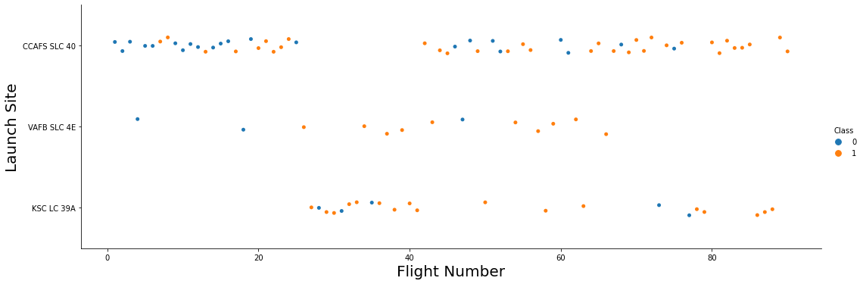
Flight Number vs. Launch Site
CCAFS SLC 40 : is the most usable site for launching SpaceX's rockets and it has 55 trials, 33 of them are successful and 22 of them are failed # 60% success rate
VAFB SLC 4E : is the least usable site for launching SpaceX's rockets and it has 13 trials, 10 of them are successful and 03 of them are failed # 77% success rate
VAFB SLC 4E : is a moderate site in terms of launching SpaceX's rockets and it has 22 trials, 17 of them are successful and 05 of them are failed # 77% success rate
18

Slide 19
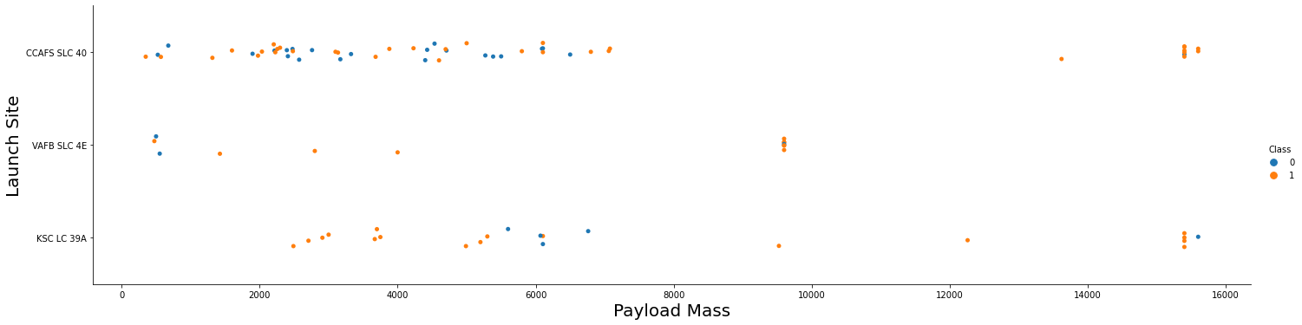
Payload vs. Launch Site
According to the plot above:
there is no strong relationship between the payload mass and the success of first stage return since there are approximately equivalent numbers of failed and successful trials.

Slide 20
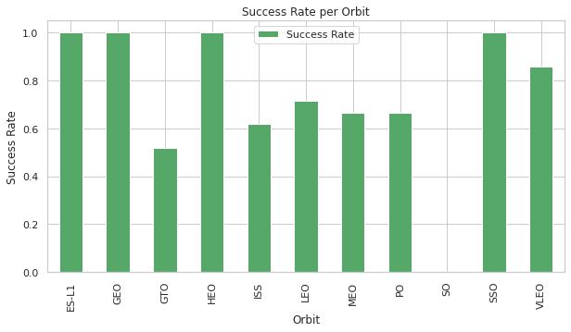
Success Rate vs. Orbit Type
According to the bar plot :
The best orbits in terms of successful first stage returns are ['ES-L1', 'GEO', HEO, SSO]
Where the worst orbit is 'GTO’ , therefore we need to understand why it is the worst to avoid the failure of first stage return.

Slide 21
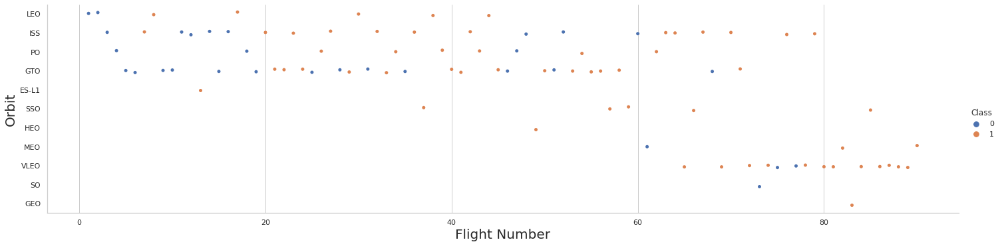
Flight Number vs. Orbit Type
We can see that in the LEO orbit the Success appears related to the number of flights; on the other hand, there seems to be no relationship between flight number when in GTO orbit.

Slide 22
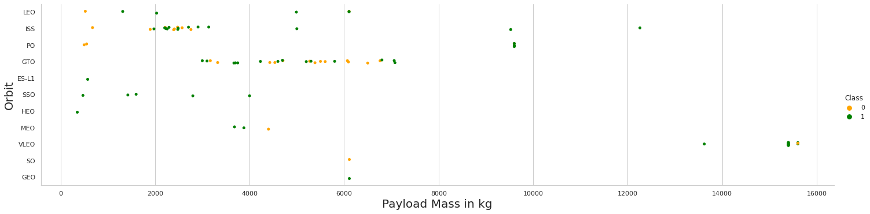
Payload vs. Orbit Type
We observe that Heavy payloads have a negative influence on GTO orbits and positive on GTO and
Polar LEO (ISS) orbits.

Slide 23
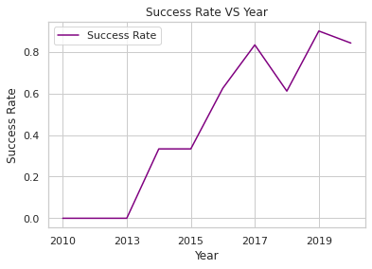
Launch Success Yearly Trend
We can observe that the success rate since 2013 kept increasing till 2020

Slide 24
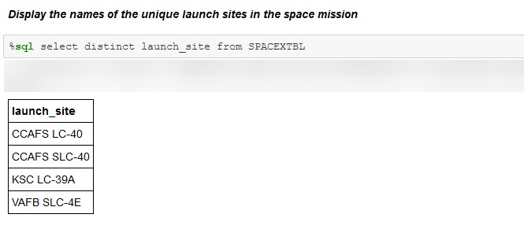
All Launch Site Names
As shown above we have 4 distinct sites for rockets launches listed in the Table above.

Slide 25
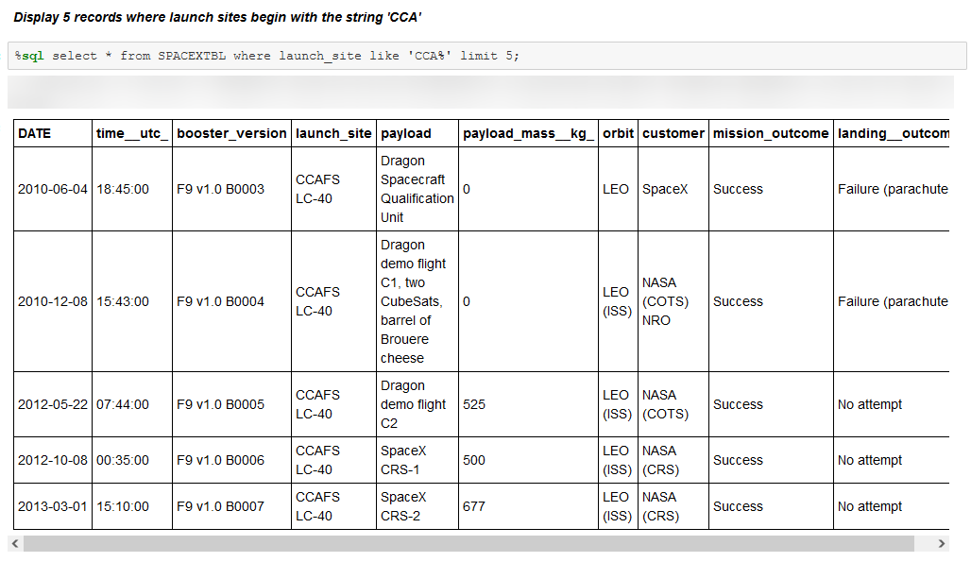
Launch Site Names Begin with 'CCA'

Slide 26
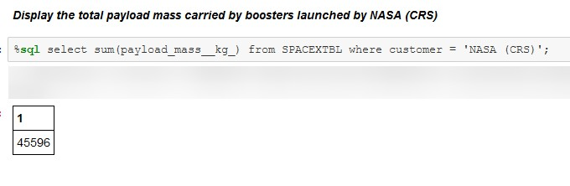
Total Payload Mass
The total amount of payload that moved to the outer space by NASA through SpaceX rockets equals to 45596 Kg which is equal to 50.261 Us ton.

Slide 27
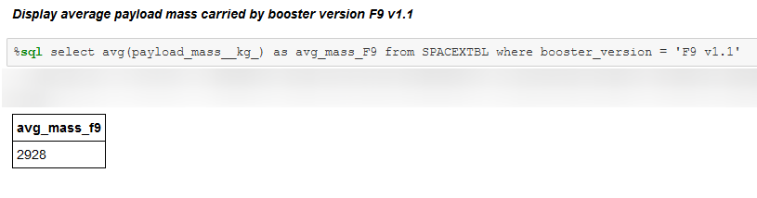
Average Payload Mass by F9 v1.1
The average payload mass carried by booster version F9 v1.1 is 2928 kg

Slide 28
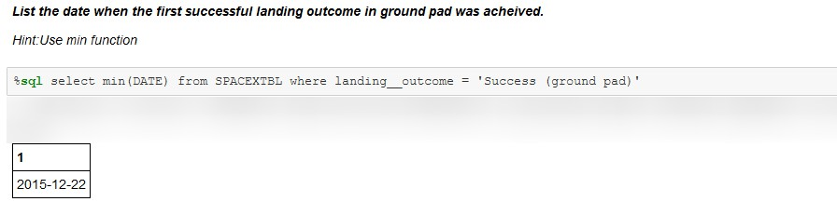
First Successful Ground Landing Date
Date of the first successful landing outcome on ground pad was in 22-12-2015

Slide 29
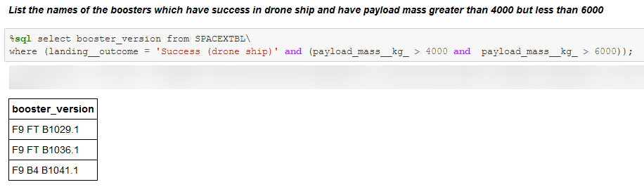
Successful Drone Ship Landing with Payload between 4000 and 6000
The boosters which have success in drone ship landing with payload between 4000 and 6000 kg are :
F9 FT B1029.1
F9 FT B1036.1
F9 B4 B1041.1

Slide 30
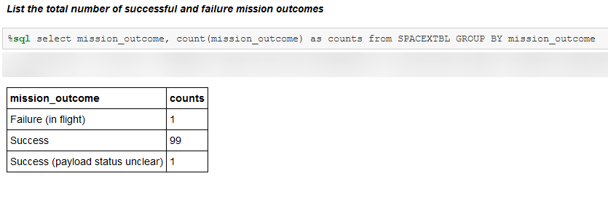
Total Number of Successful and Failure Mission Outcomes
We can see clearly that the success rate of mission outcomes is the most dominant we have only 1 failed mission while we have 99 successful ones.

Slide 31
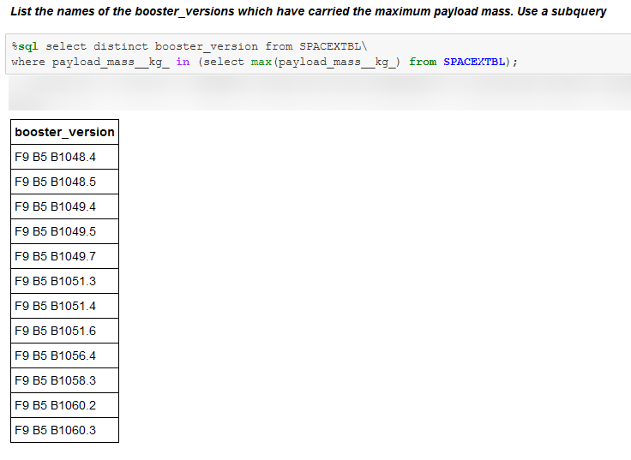
Boosters Carried Maximum Payload
The booster versions that carry the maximum payload starts with F9 B5 and ranges from B1048 up to B1060

Slide 32
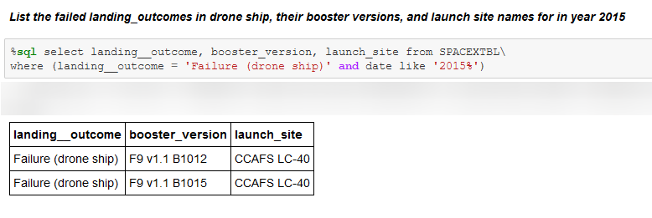
2015 Launch Records
We have two failed landing in 2015 on a drone ship which both in the same site, CCAFS LC-40 and with same booster version F9 v1.1

Slide 33
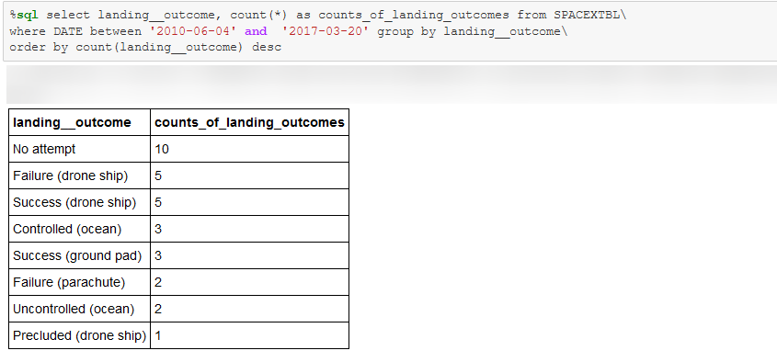
Rank Landing Outcomes Between 2010-06-04 and 2017-03-20

Slide 34


Slide 35
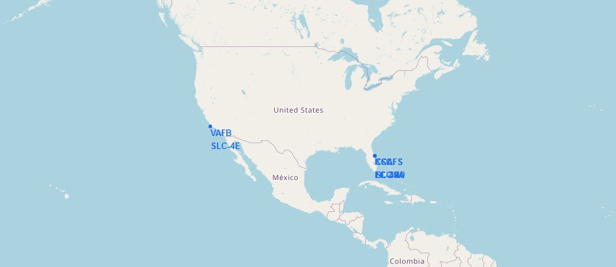
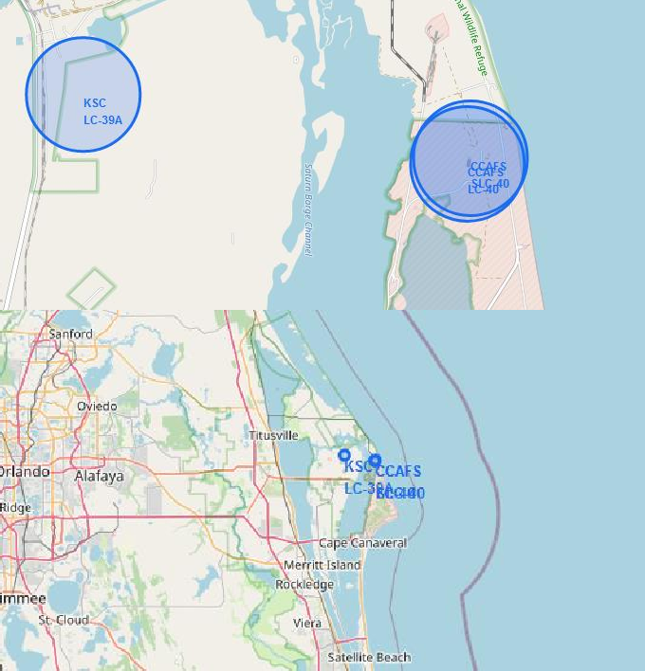
Folium Map: Launch Sites.
All site locations are near the coast and Equator line, SpaceX focuses on locations that are close to water and the zeroth latitude for the purpose of avoiding any undesired accidents.
The launch sites are distributed in two states California and Florida
35

Slide 36
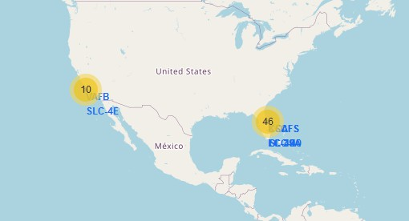
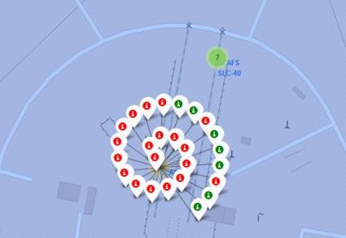
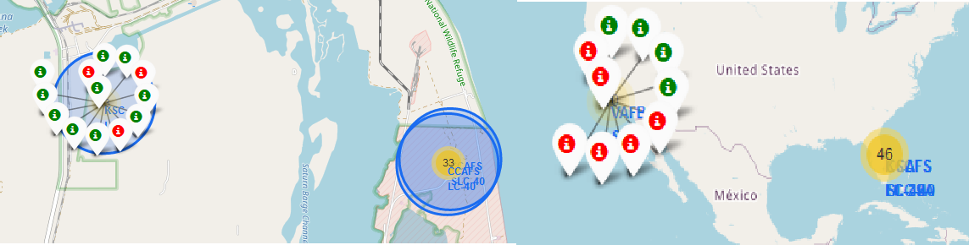
Folium Map: Success rate for each launch location
From the color-labeled markers in marker clusters, we can easily identify which launch sites have relatively high success rates.
Green Marker = Successful Return Red Marker = Failed Return

Slide 37
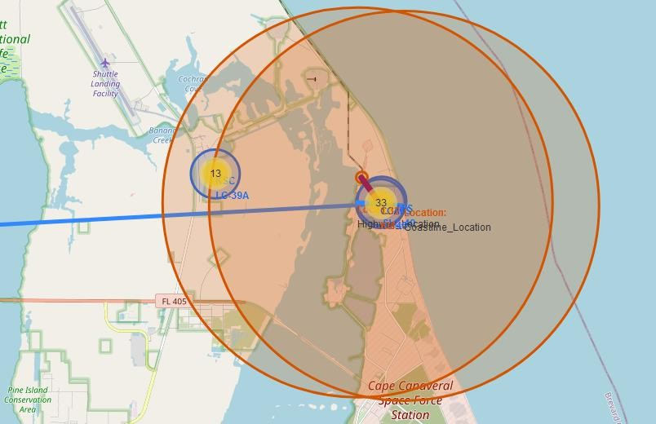
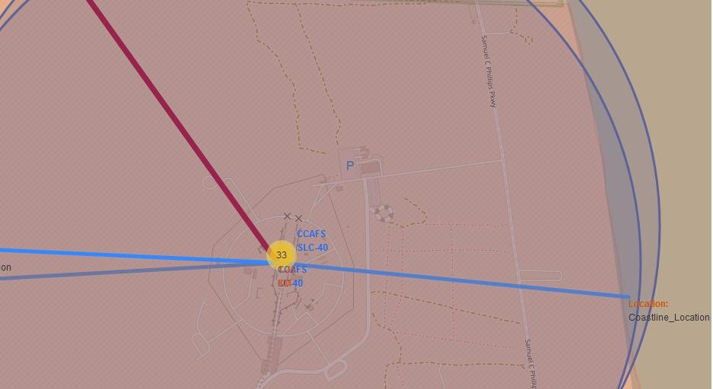
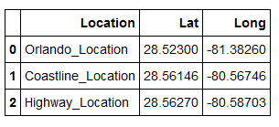
Folium Map: Closest Proximities to CCAFS LC-40
Proximities Cordinates
we calculated the distances between the launch site (CCAFS LC-40) to its proximities
Orlando City Distance ≈ 78.8 Km, Coastline Distance ≈ 0.97 Km, Highway Distance ≈ 0.95Km

Slide 38


Slide 39
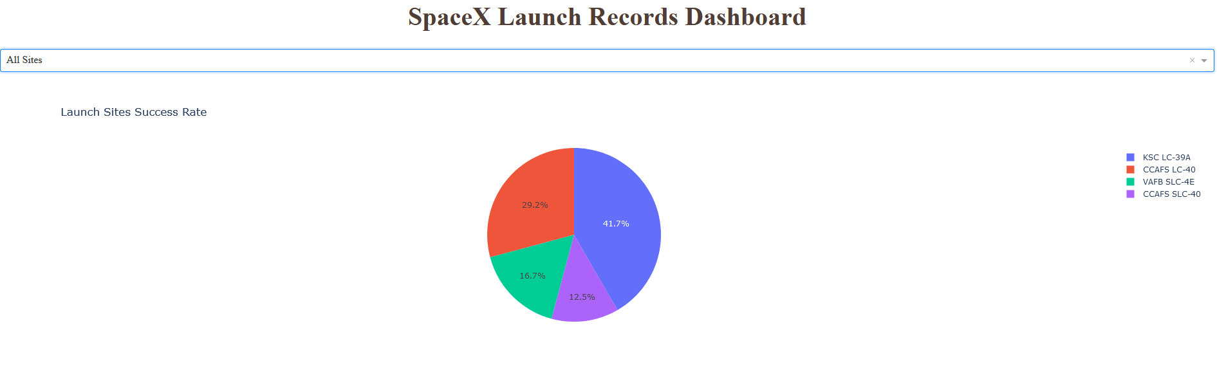
Dashboard: Launch success count for all sites
The graph shows the success percentage for every single site in terms of first stage return:
The best site is KSC LC-39A with 41.7%. of total successful rocket launch among all sites
The least site for successful rocket launch: CCAFS SLC-40 with only12.5%.
39

Slide 40
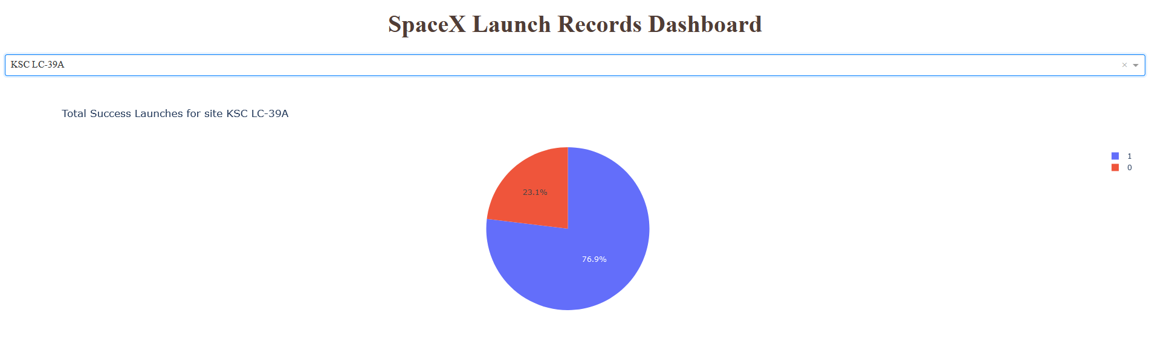
Dashboard: Launch success for KSC LC 39A
Total Success Launches for site KSC LC-39
KSC LC-39A with 76.9% successful missions
KSC LC-39A with 23.1% Failed missions
40

Slide 41
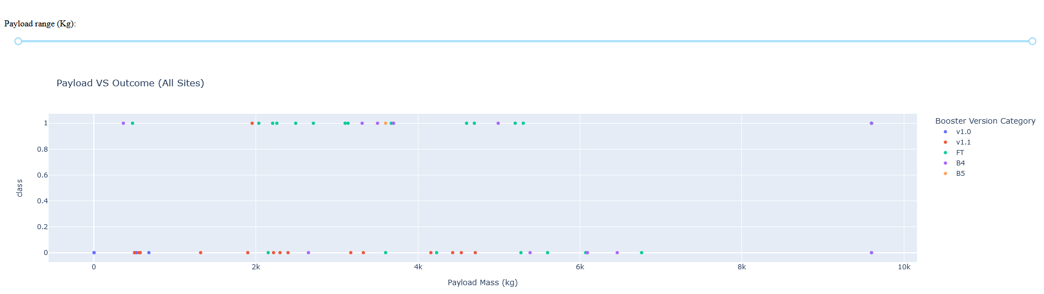
<Dashboard Screenshot 3>
This interactive scatter plot shows the launch outcome based on the relationship between the payload mass and the final outcomes as we can infer that the success rate per booster version for example, the payload mass < 4000 kg more likely to be successful.
41

Slide 42


Slide 43
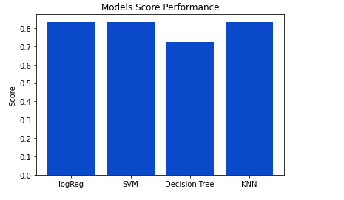
Classification Accuracy
Logistic Regression , SVM and KNN has the same performance where the Jaccard Score is same : 0.8
Where Decision Tree has the worst performance compared to other models.
43

Slide 44
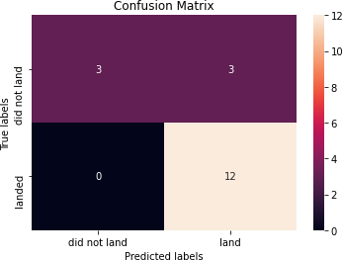
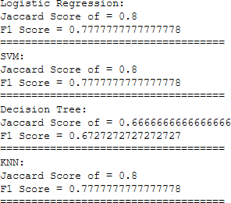

Logistic Regression , SVM and KNN have the same confusion matrix and results:
True Positive = 12
False Positive = 0
True Negative = 3
Confusion Matrix
False Negative = 3
44

Slide 45







Conclusions
a successful first stage return, leads to huge savings in terms of rockets lunches cost
A wide range of attributes affects the possibility of a successful first stage return. In our model there were 83 attributes were taken into consideration.
SpaceX Falcon9 launch sites were all close to a highway, railway, and coastline proximities, which aimed in transportation cost-reduction
insight requires further investigation. SpaceX success rate increased with years, KSC LC – 39A site is the highest in success rate.
Orbit and booster version affect success rate.
45

Slide 46
